Slide 1
Entity Resolution for Big Data
Lise Getoor
University of Maryland College Park, MD
Ashwin Machanavajjhala
Duke University
Durham, NC
http://www.cs.umd.edu/~getoor/Tutorials/ER_KDD2013.pdf
http://goo.gl/7tKiiL

Slide 2
What is Entity Resolution?
Problem of identifying and linking/grouping different manifestations of the same real world object.
Examples of manifestations and objects:
Different ways of addressing (names, email addresses, FaceBook accounts) the same person in text.
Web pages with differing descriptions of the same business.
Different photos of the same object.
…
Notes:
Todo: make these more exciting/precise

Slide 3

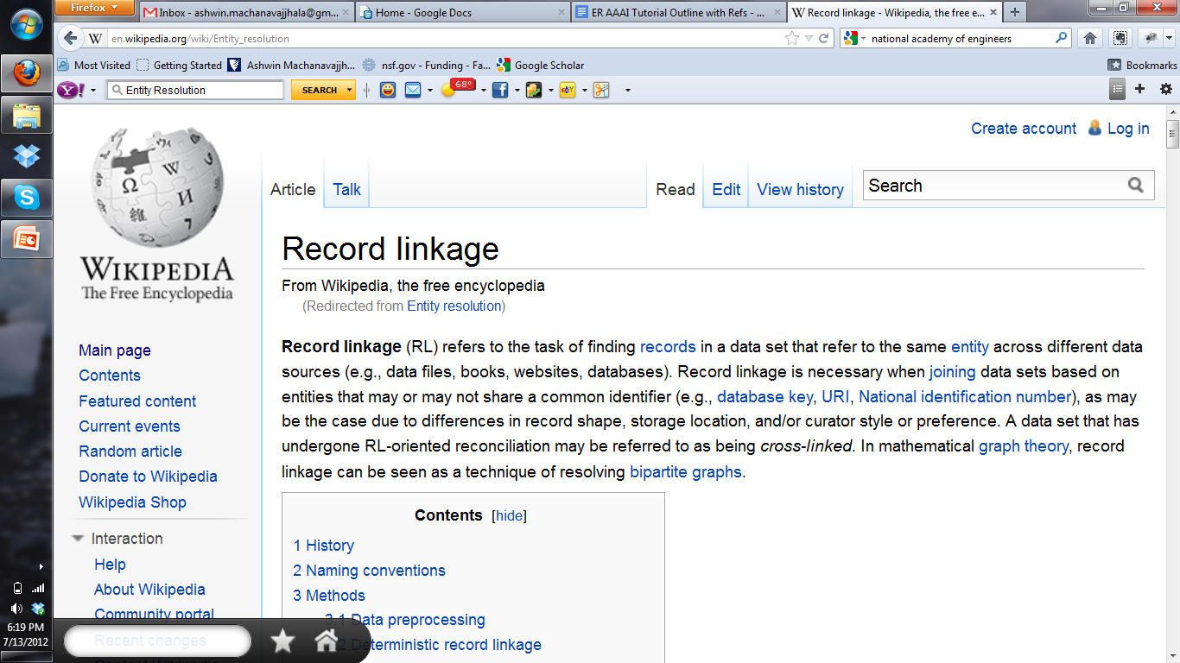
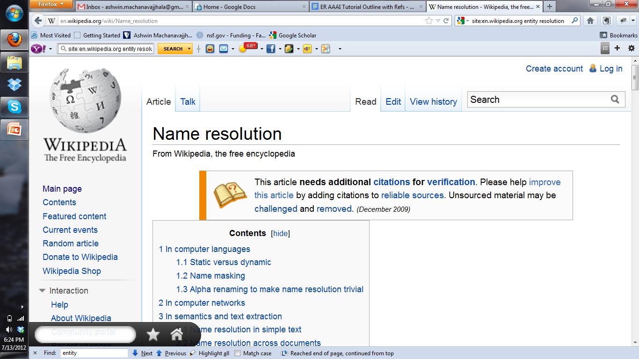
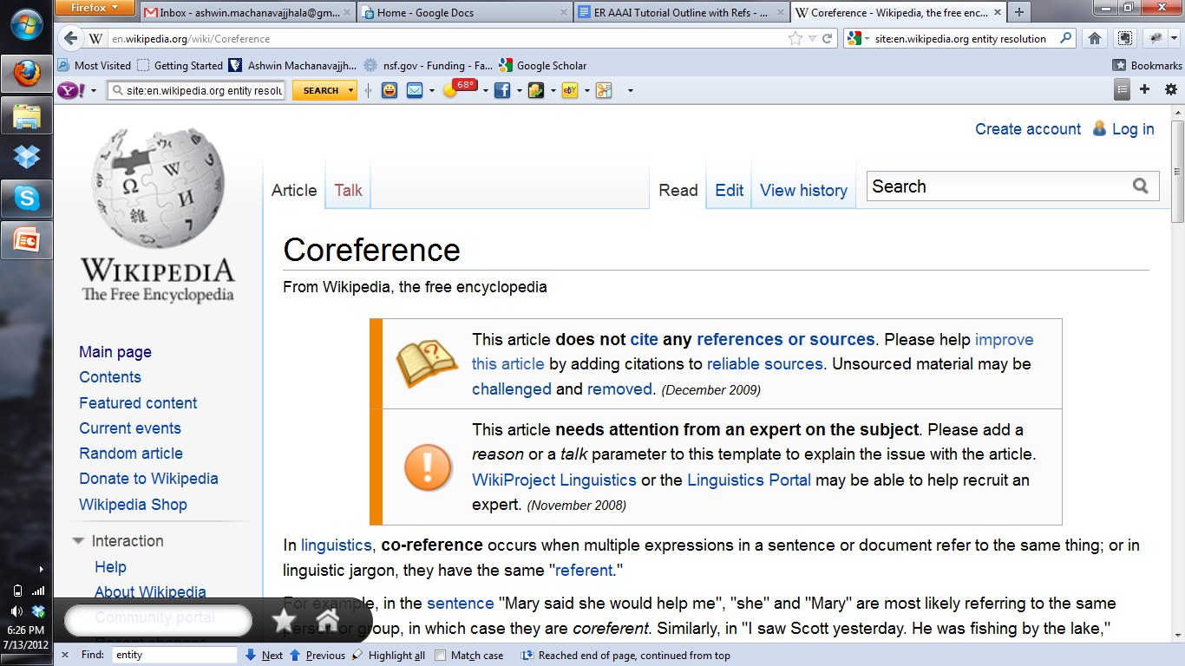
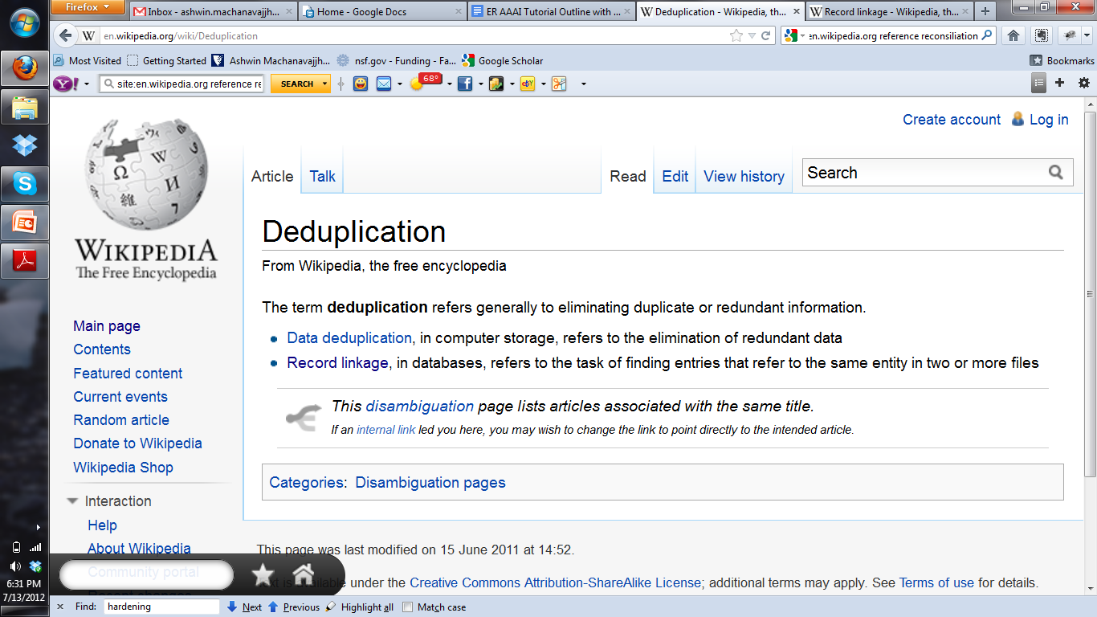
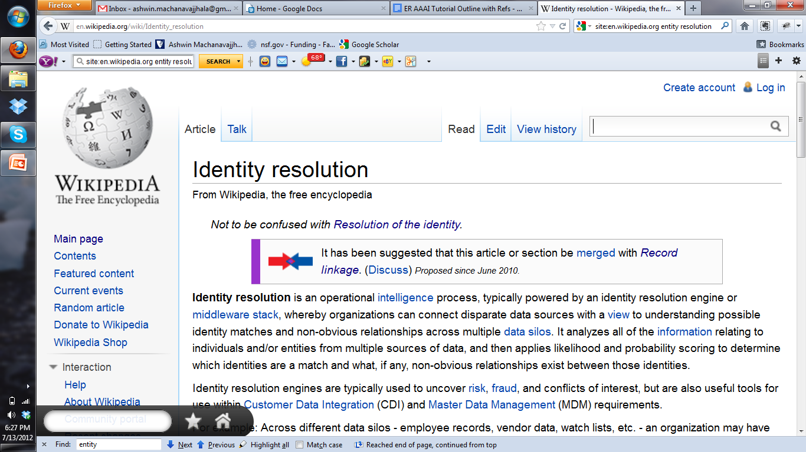
What is Entity Resolution?

Slide 4
Ironically, Entity Resolution has many duplicate names
Record linkage
Duplicate detection
Coreference resolution
Reference reconciliation
Fuzzy match
Object consolidation
Object identification
Deduplication
Entity clustering
Approximate match
Identity uncertainty
Merge/purge
Household matching
Hardening soft databases
Householding
Reference matching
Doubles

Slide 5
ER Motivating Examples
Linking Census Records
Public Health
Web search
Comparison shopping
Counter-terrorism
Knowledge Graph Construction
…
Notes:
Web search – query disambiguation

Slide 6
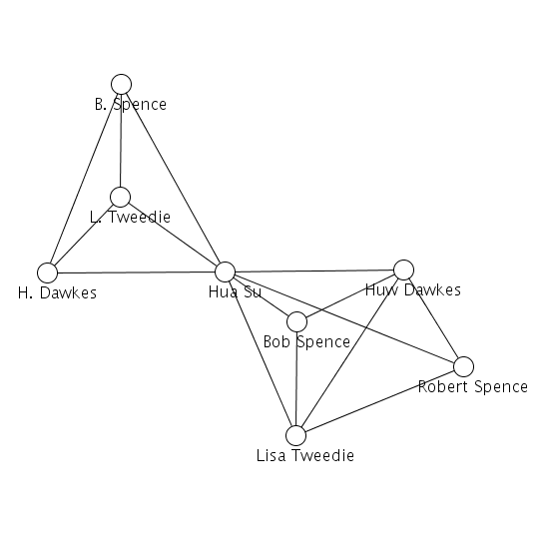
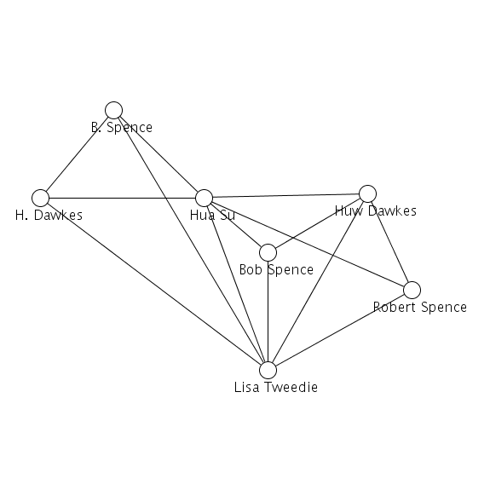
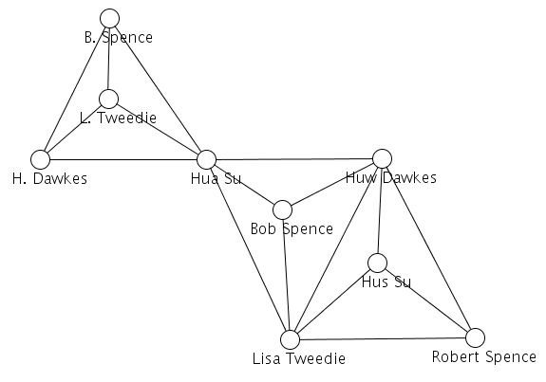
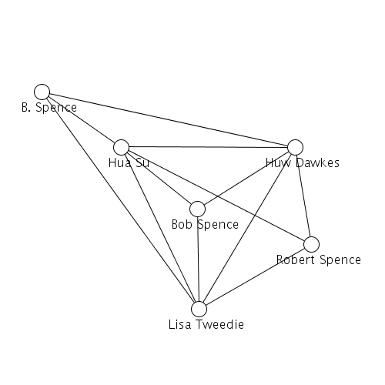
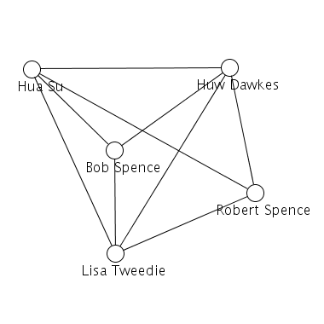
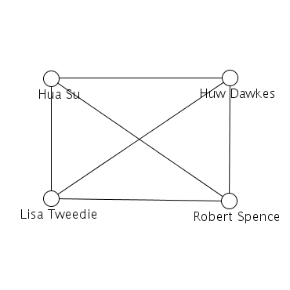
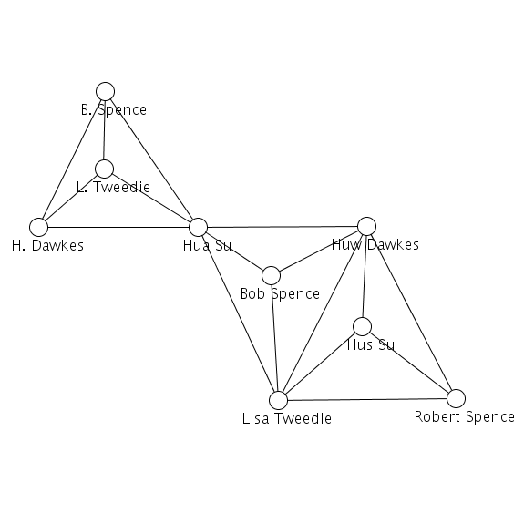
Motivation: ER and Network Analysis
before
after

Slide 7
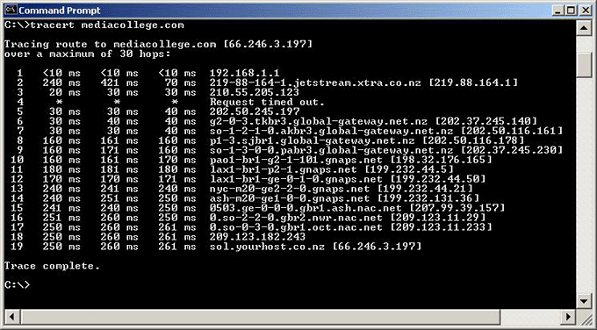
Motivation: ER and Network Analysis
Measuring the topology of the internet … using traceroute

Slide 8
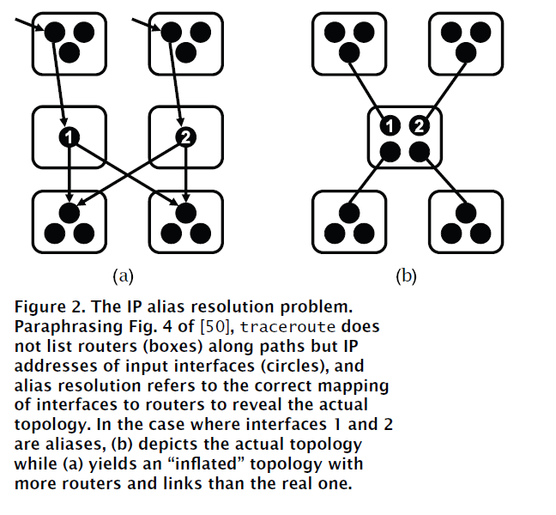
IP Aliasing Problem [Willinger et al. 2009]

Slide 9
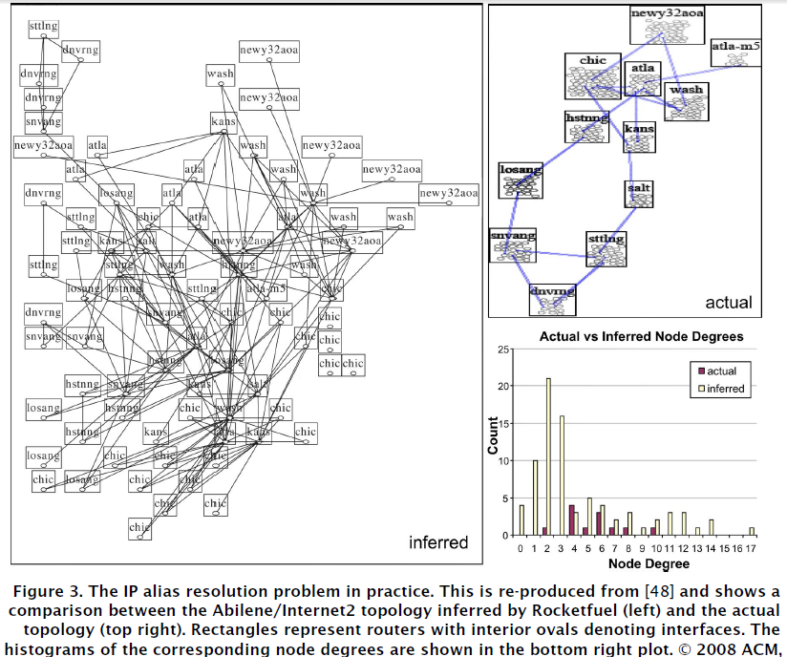
IP Aliasing Problem [Willinger et al. 2009]

Slide 10
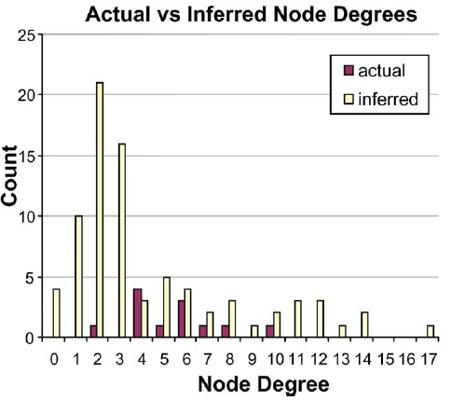
IP Aliasing Problem [Willinger et al. 2009]

Slide 11




Traditional Challenges in ER
Name/Attribute ambiguity
Thomas Cruise
Michael Jordan

Slide 12

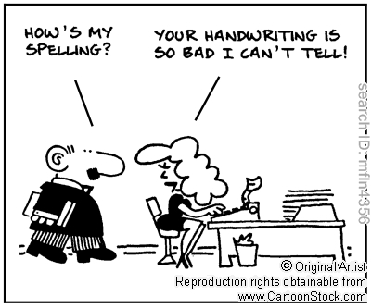
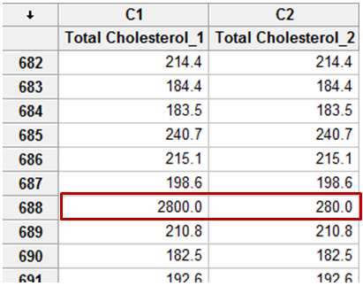
Traditional Challenges in ER
Name/Attribute ambiguity
Errors due to data entry

Slide 13
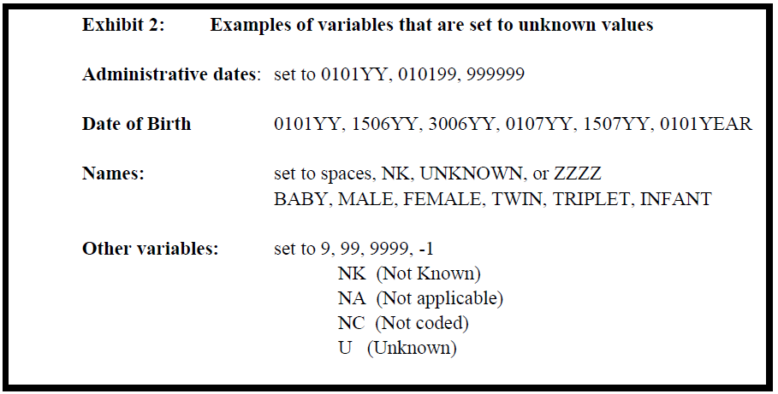
Traditional Challenges in ER
Name/Attribute ambiguity
Errors due to data entry
Missing Values
[Gill et al; Univ of Oxford 2003]

Slide 14

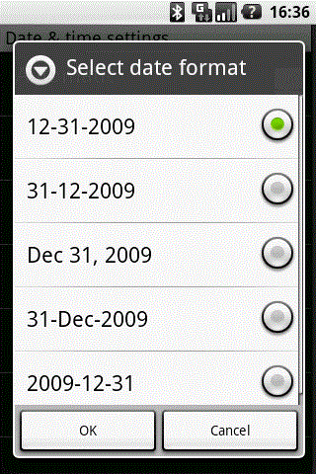
Traditional Challenges in ER
Name/Attribute ambiguity
Errors due to data entry
Missing Values
Changing Attributes
Data formatting
Abbreviations / Data Truncation

Slide 15

Big-Data ER Challenges

Slide 16
Big-Data ER Challenges
Larger and more Datasets
Need efficient parallel techniques
More Heterogeneity
Unstructured, Unclean and Incomplete data. Diverse data types.
No longer just matching names with names, but Amazon profiles with browsing history on Google and friends network in Facebook.

Slide 17
Big-Data ER Challenges
Larger and more Datasets
Need efficient parallel techniques
More Heterogeneity
Unstructured, Unclean and Incomplete data. Diverse data types.
More linked
Need to infer relationships in addition to “equality”
Multi-Relational
Deal with structure of entities (Are Walmart and Walmart Pharmacy the same?)
Multi-domain
Customizable methods that span across domains
Multiple applications (web search versus comparison shopping)
Serve diverse application with different accuracy requirements

Slide 18
Outline
Abstract Problem Statement
Algorithmic Foundations of ER
Scaling ER to Big-Data
Challenges & Future Directions

Slide 19
Outline
Abstract Problem Statement
Algorithmic Foundations of ER
Data Preparation and Match Features
Pairwise ER
Constraints in ER
Algorithms
Record Linkage
Deduplication
Collective ER
Scaling ER to Big-Data
Challenges & Future Directions
10 minute break

Slide 20
Outline
Abstract Problem Statement
Algorithmic Foundations of ER
Scaling ER to Big-Data
Blocking/Canopy Generation
Distributed ER
Challenges & Future Directions

Slide 21
Outline
Abstract Problem Statement
Algorithmic Foundations of ER
Scaling ER to Big-Data
Challenges & Future Directions

Slide 22
Scope of the Tutorial
What we cover:
Fundamental algorithmic concepts in ER
Scaling ER to big datasets
Taxonomy of current ER algorithms
What we do not cover:
Schema/ontology resolution
Data fusion/integration/exchange/cleaning
Entity/Information Extraction
Privacy aspects of Entity Resolution
Details on similarity measures
Technical details and proofs

Slide 23
ER References
Book / Survey Articles
Data Quality and Record Linkage Techniques [T. Herzog, F. Scheuren, W. Winkler, Springer, ’07]
Duplicate Record Detection [A. Elmagrid, P. Ipeirotis, V. Verykios, TKDE ‘07]
An Introduction to Duplicate Detection [F. Naumann, M. Herschel, M&P synthesis lectures 2010]
Evaluation of Entity Resolution Approached on Real-world Match Problems [H. Kopke, A. Thor, E. Rahm, PVLDB 2010]
Data Matching [P. Christen, Springer 2012]
Tutorials
Record Linkage: Similarity measures and Algorithms [N. Koudas, S. Sarawagi, D. Srivatsava SIGMOD ‘06]
Data fusion--Resolving data conflicts for integration [X. Dong, F. Naumann VLDB ‘09]
Entity Resolution: Theory, Practice and Open Challenges http://goo.gl/Ui38o [L. Getoor, A. Machanavajjhala AAAI ‘12]

Slide 24
Abstract Problem Statement
PART 1

Slide 25









Abstract Problem Statement
Real World
Digital World
Records / Mentions

Slide 26
Deduplication Problem Statement
Cluster the records/mentions that correspond to same entity

Slide 27

Deduplication Problem Statement
Cluster the records/mentions that correspond to same entity
Intensional Variant: Compute cluster representative

Slide 28
Record Linkage Problem Statement
Link records that match across databases
B
A

Slide 29
Reference Matching Problem
Match noisy records to clean records in a reference table
Reference Table

Slide 30






Abstract Problem Statement
Real World
Digital World
AI
ML
DB

Slide 31
Deduplication Problem Statement

Slide 32
Deduplication with Canonicalization
AI

Slide 33
Link Prediction Problem Statement

Slide 34

Graph/Motif Alignment
Graph 1
Graph 2
Notes:
Motif search is a special case where the
Lcg: took out & motif alignment in the title, complicates things. Think about what are important poitns to get across

Slide 35
Relationships are crucial

Slide 36
Relationships are crucial

Slide 37
Notation
R: set of records / mentions (typed)
H: set of relations / hyperedges (typed)
M: set of matches (record pairs that correspond to same entity )
N: set of non-matches (record pairs corresponding to different entities)
E: set of entities
L: set of links
True (M_{true}, N_{true}, E_{true}, L_{true}): according to real world vs Predicted (M_{pred}, N_{pred}, E_{pred}, L_{pred} ): by algorithm

Slide 38
Relationship between M_{true} and M_{pred}
M_{true} (SameAs , Equivalence)
M_{pred} (Similar representations and similar attributes)
RxR
M_{true}
M_{pred}
Notes:
Reference: p. 13, Principles of Entity Resolution
Discuss false positive (type1) / false negative (typeII)
Mention imbalance in size
Typically focus of evaluation is on positives
Most ER systems designed to avoid false positives, at expense of creating flase negatives.
(e.g., better to have two accounts for one customer that to merge the accounts of two different customers)

Slide 39
Metrics
Pairwise metrics
Precision/Recall, F1
# of predicted matching pairs
Cluster level metrics
purity, completeness, complexity
Precision/Recall/F1: Cluster-level, closest cluster, MUC, B³ , Rand Index
Generalized merge distance [Menestrina et al, PVLDB10]
Little work that evaluates correct prediction of links
Notes:
http://nlp.uned.es/docs/amigo2007a.pdf
By complexity I mean, description complexity

Slide 40
Typical Assumptions Made
Each record/mention is associated with a single real world entity.
In record linkage, no duplicates in the same source
If two records/mentions are identical, then they are true matches
( , ) ε M_{true}

Slide 41
ER versus Classification
Finding matches vs non-matches is a classification problem
Imbalanced: typically O(R) matches, O(R^2) non-matches
Instances are pairs of records. Pairs are not IID
( , ) ε M_{true}
AND
( , ) ε M_{true}
( , ) ε M_{true}

Slide 42
ER vs (Multi-relational) Clustering
Computing entities from records is a clustering problem
In typical clustering algorithms (k-means, LDA, etc.) number of clusters is a constant or sub linear in R.
In ER: number of clusters is linear in R, and average cluster size is a constant. Significant fraction of clusters are singletons.

